Slide 1
Carbon Cycle

Slide 2
In this Smart Lesson, you will learn how the carbon cycle works and why it is threatened by human activity.
⋅ | Identify the steps of the carbon cycle
⋅ | Describe how carbon travels through the different spheres on Earth
⋅ | Explain how human activity has affected the levels of carbon in the atmosphere.

Slide 3
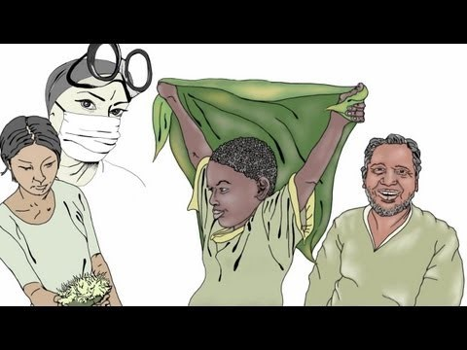

Slide 4
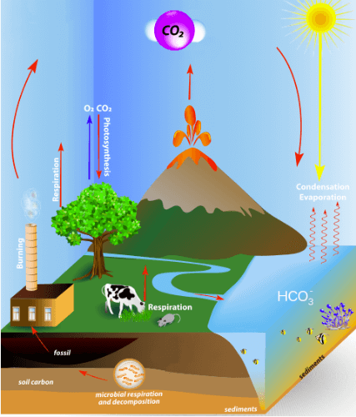
The carbon cycle is the recycling of carbon through living and non-living things.
Carbon is recycled through the soil, water, living things and the atmosphere, as seen in the image below.

Slide 5
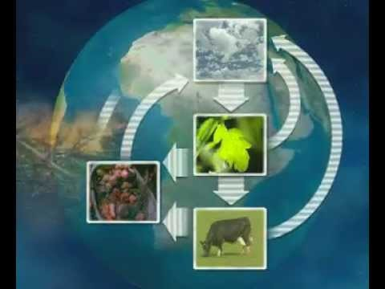

Slide 6
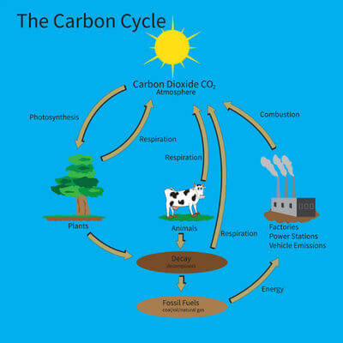
The carbon cycle occurs in several steps.
Sometimes carbon can remain in one of these steps for thousands of years before moving from one sphere to the next.

Slide 7
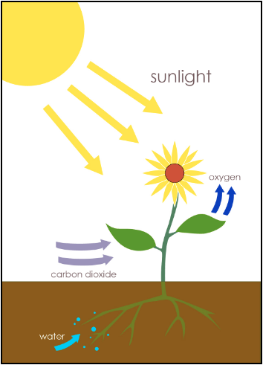
1. Carbon dioxide in the earth's atmosphere is absorbed through photosynthesis by plants and trees.
During this process, small amounts of oxygen are produced, which are released back into the atmosphere.

Slide 8
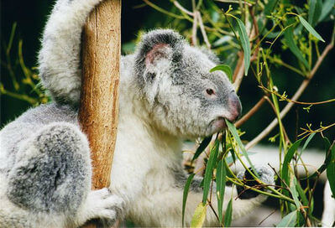
2. Plants then become food sources for animals.
As animals eat plants, they produce carbon dioxide through the process of cellular respiration. This carbon dioxide is expired as a waste product of energy generation.

Slide 9
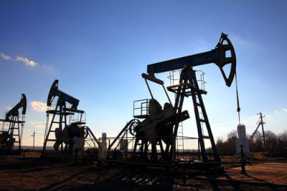
3. After an organism dies, it can decompose over thousands of years and be turned into a fossil fuel such as coal, oil or natural gas.
When these fossil fuels are used via combustion to create energy, the carbon dioxide is released back into the atmosphere.

Slide 10
4. This atmospheric carbon can be absorbed by bodies of water, or by plants through photosynthesis and so the carbon cycle begins again.

Slide 11
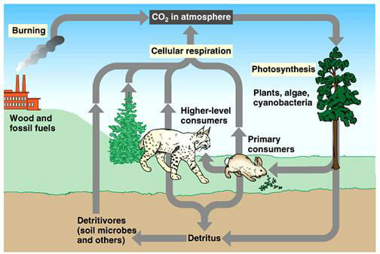
Carbon is found in the biosphere in the carbohydrates, fats, proteins, vitamins, glucose and DNA of all living things.
Carbon is gained either through absorption in photosynthesis by plants, or through consumption of plants or other organisms that eat plants.
It is released into the atmosphere through respiration, and into the lithosphere via decomposition of organisms after death.

Slide 12

Carbon enters the hydrosphere by dissolving into lakes, rivers and oceans.
In the upper layer of water, dissolved organic carbon is constantly exchanged back and forth with the atmosphere due to their close contact.
In the lower layers, however, dissolved inorganic carbon can remain stored for thousands of years until ocean currents cause the dissolved inorganic carbon to move to the upper layer.

Slide 13
Atmospheric carbon is mostly in the form of carbon dioxide (CO2​), but also as methane (CH4​).
Carbon is released into the atmosphere via respiration of organisms, volcanic emissions, decomposition of living things, animal waste (faeces) and burning of fossil fuels.
It is removed from the atmosphere by photosynthesis of plants, or dissolving into a body of water.

Slide 14
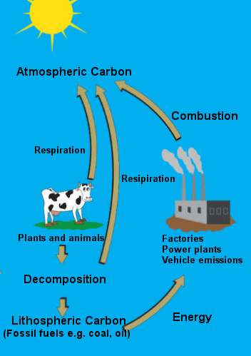
Carbon enters the lithosphere mainly through the decomposition of organisms by bacteria, after an organism's death.
Carbon can often stay in the lithosphere (and eventually become fossil fuels) for thousands of years, before entering the atmosphere when fossil fuels are burnt for energy by humans.

Slide 15
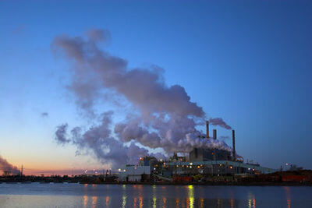
95% of the atmospheric carbon would be present regardless of whether humans existed.
However, in recent years humans have become responsible for an increasing amount of the carbon released into the atmosphere.
As we burn fuel, either in our bodies or in machines, we release carbon dioxide into the atmosphere.

Slide 16

Around 200 years ago, humans turned to machines to increase production rates and efficiency in what is known as the Industrial Revolution. Before this, little fossil fuels were burnt and most things were made by hand.
The recycling capabilities of the Earth's plants was enough to be able to absorb the carbon dioxide and release oxygen back into the atmosphere, keeping their levels in balance.

Slide 17
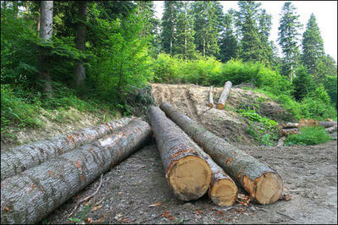
As we burn more fossil fuels, continue to cut down trees for population growth and agriculture and find more ways to release carbon into the atmosphere, the ratio between oxygen and carbon is becoming less balanced.

Slide 18
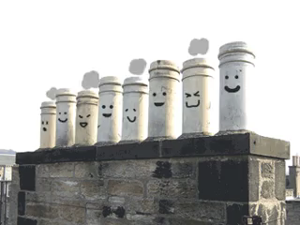
This is because humans have been releasing more CO₂​ than has been released previously in Earth's history and cutting down the trees that would usually absorb the atmospheric CO₂​.
We have been increasing release, and decreasing the ability to absorb and stabilise the CO₂​ levels.

Slide 19
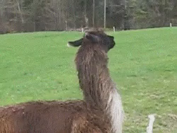
Agriculture, or farming, has also led to to an increase in the number of livestock and a corresponding decrease in forests and trees for space to graze.
Cows produce a large amount of methane (CH4​) due to the digestive bacteria in their stomachs, which causes flatulence and belching (farts and burps).

Slide 20
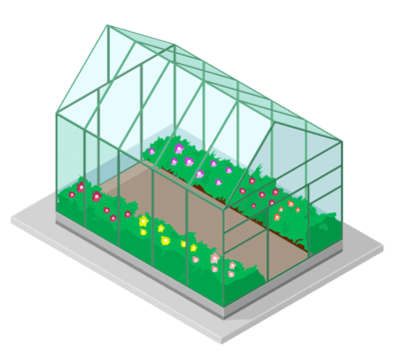
Both carbon dioxide and methane are greenhouse gases. An increased amount of the two gases in the atmosphere can cause the temperature on Earth to rise.
This is because they act much like the glass of a greenhouse and trap heat.

Slide 21

Another negative effect of this increased release of carbon into the atmosphere is the acidification of our oceans.
Oceans are one of the largest absorbers of atmospheric carbon dioxide and help to keep the atmospheric carbon levels low.

Slide 22
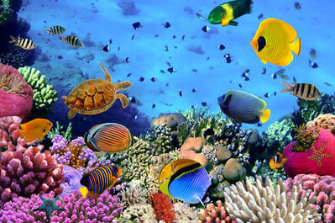
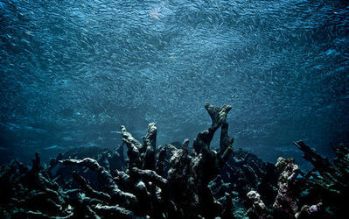
However, the more carbon dioxide the oceans absorb, the lower the pH or more acidic they become, which can be detrimental to organisms that live there.
This can decrease oceanic biodiversity, and reduce food sources humans who eat seafood.

